Slide 1


Visvesvaraya Technological University, Belagavi.
Prerana Educational and Social Trust®
PES INSTITUTE OF TECHNOLOGY AND MANAGEMENT SHIVAMOGGA
NH-206, Sagar Road, Shivamogga -577204
COMPUTER SCIENCE AND ENGINEERING (DATA SCIENCE)
Artificial Intelligence and Machine Learning(BDS602)
Assignment Project
Resume Classification and Shortlisting System using NLP and Machine Learning
Presented By:
R P Nagashri Sajjan | 4PM22CDO36
Sinchana P | 4PM22CDO50
Soundarya S P | 4PM22CDO53
Zeenath Banu S | 4PM22CD063
Project guide:
Head of Department:
Ms. Sneha S
Dept of CSDS.
Dr. Sunitha B S,
HOD, Dept of CSDS

Slide 2


Contents
Introduction
Problem Statement
Objectives
Methodology
Implementation
Result Analysis
Conclusion
References
DEPARTMENT OF CSDS, PESITM

Slide 3
Introduction
In today’s competitive job market, Human Resource (HR) departments receive thousands of resumes for a single job posting. Manually screening and shortlisting candidates is time-consuming, prone to bias, and inefficient. With advancements in Natural Language Processing (NLP) and Machine Learning (ML), automating the resume screening process has become more feasible and accurate. This project, titled “Resume Classification and Shortlisting System using NLP and Machine Learning”, aims to develop a system that classifies resumes into suitable job roles and shortlists the best-matching resumes for download in a structured format.
DEPARTMENT OF CSDS, PESITM

Slide 4
Problem Statement
The manual process of resume screening is labour-intensive and slow, often leading to delays in recruitment and overlooked potential candidates. HR professionals must go through numerous resumes to identify suitable candidates for specific roles, which increases operational overhead and decreases efficiency. There is a need for a smart system that can automatically categorize resumes based on job role relevance and highlight the most suitable ones.
DEPARTMENT OF CSDS, PESITM

Slide 5
Objectives
To design and develop a resume screening system that automatically classifies resumes into predefined job categories.
To apply Natural Language Processing techniques for cleaning and transforming textual data.
To use machine learning models for effective classification and shortlisting.
To identify and shortlist the best-matching resumes for selected job roles.
To export shortlisted resumes as a CSV file for practical use by HR teams.
To visualize the distribution of job roles and filtered resumes through graphical analysis.
DEPARTMENT OF CSDS, PESITM

Slide 6
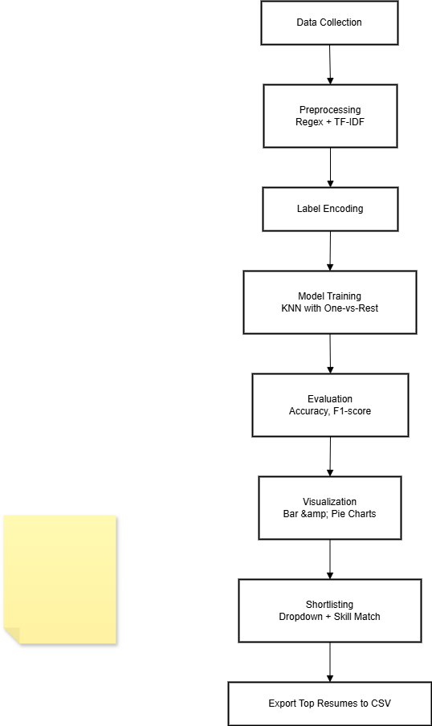
Proposed Methodology
DEPARTMENT OF CSDS, PESITM

Slide 7
Implementation
Dataset used: Cleaned_Resume_Data.csv.
Libraries: Pandas, NLTK, Scikit-learn, Matplotlib.
Steps:
Cleaned and tokenized resume text.
Extracted features using TF-IDF.
Applied KNN for job role classification.
Matched skills to compute match scores.
Filtered top resumes based on job role and score.
DEPARTMENT OF CSDS, PESITM

Slide 8
Role of TF-IDF in Resume Prediction
Role of TF-IDF in Resume Prediction :
The uploaded resume is first cleaned and preprocessed.
TF-IDF transforms the text into a numeric feature vector
Each word gets a score based on its frequency and importance.
This vector represents the semantic content of the resume.
TF-IDF helps highlight important keywords relevant to job roles.
The vector is then passed to the classifier (KNN) for prediction.
DEPARTMENT OF CSDS, PESITM

Slide 9
Role of KNN in Resume Prediction
The feature vector from TF-IDF is compared to existing labeled resumes.
KNN calculates the distance/similarity to other resumes.
Selects the K most similar resumes from the training data.
The majority job category among these neighbors is chosen.
The model predicts the job category for the new resume.
Output:Most likely job role like Data Scientist, Web Developer, etc
DEPARTMENT OF CSDS, PESITM

Slide 10
Result Analysis
The model successfully classified resumes into predefined job categories. Accuracy of classification using TF-IDF + KNN : ~97% .
Pie/bar charts show role distribution and resume match.
HR can view and download best-matching resumes easily.
DEPARTMENT OF CSDS, PESITM

Slide 11
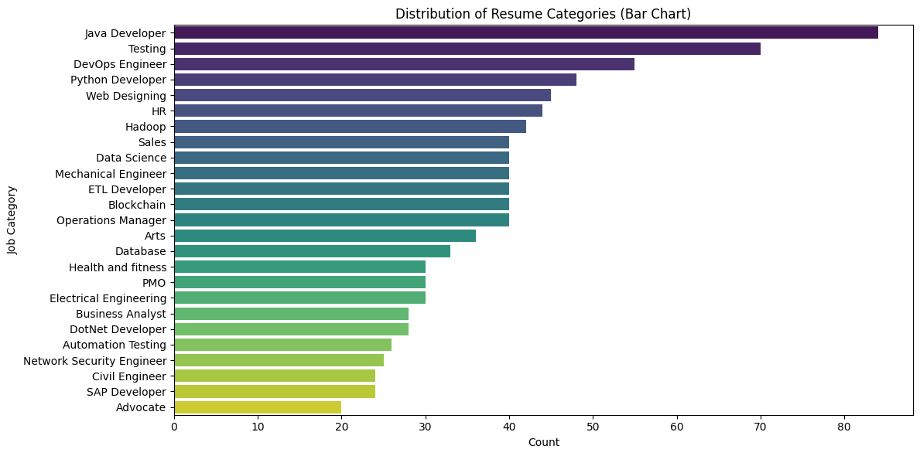
Result Analysis
Figure 1:Distribution of Resume categories in dataset
DEPARTMENT OF CSDS, PESITM

Slide 12
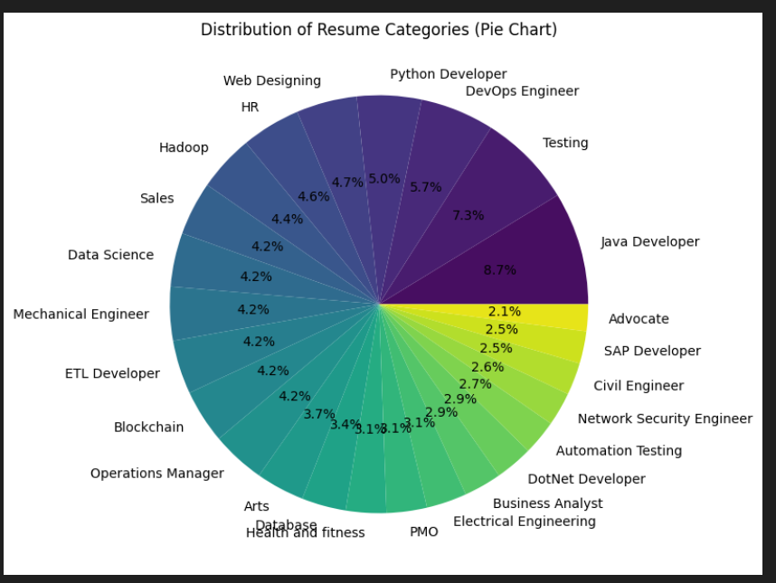
Result Analysis
Figure 2: Distribution of Resume Categories
DEPARTMENT OF CSDS, PESITM

Slide 13
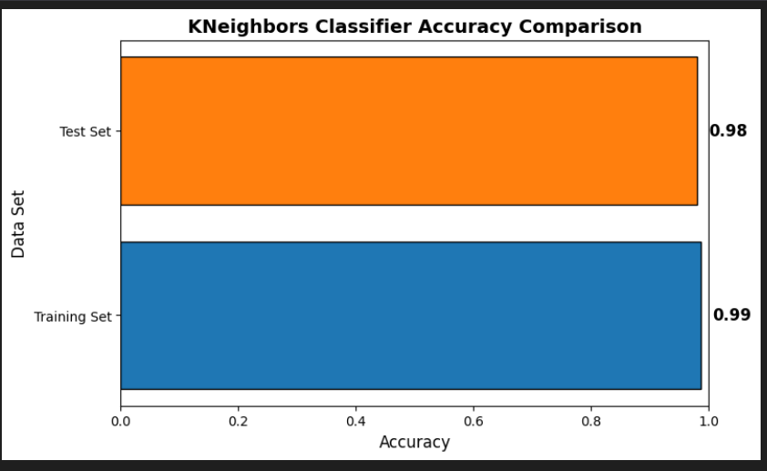
Result Analysis
Figure 3: K Neighbours Classifier Accuracy Comparison
DEPARTMENT OF CSDS, PESITM

Slide 14
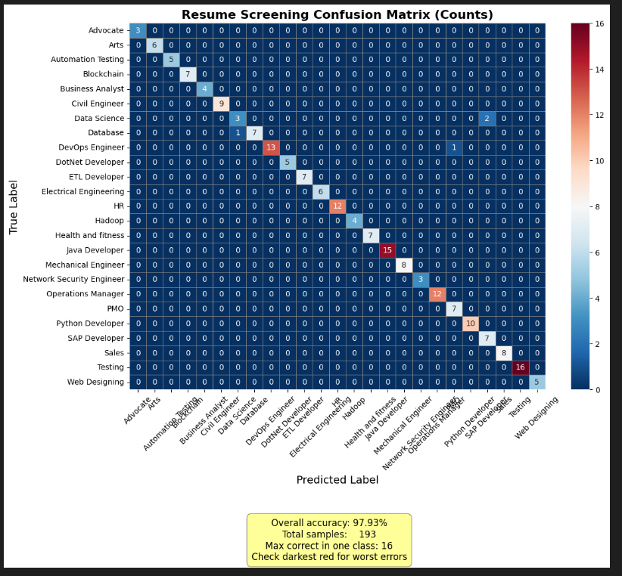
Result Analysis
Figure 4: Resume Screening Confusion Matrix(counts)
DEPARTMENT OF CSDS, PESITM

Slide 15
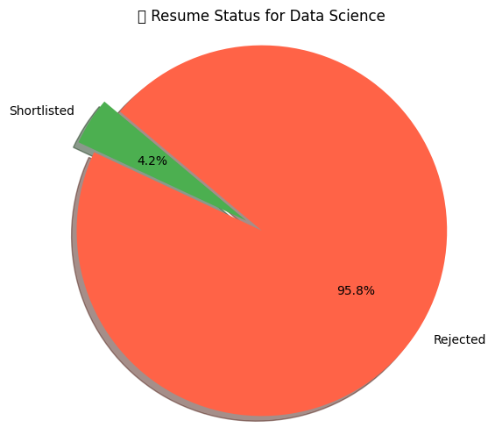
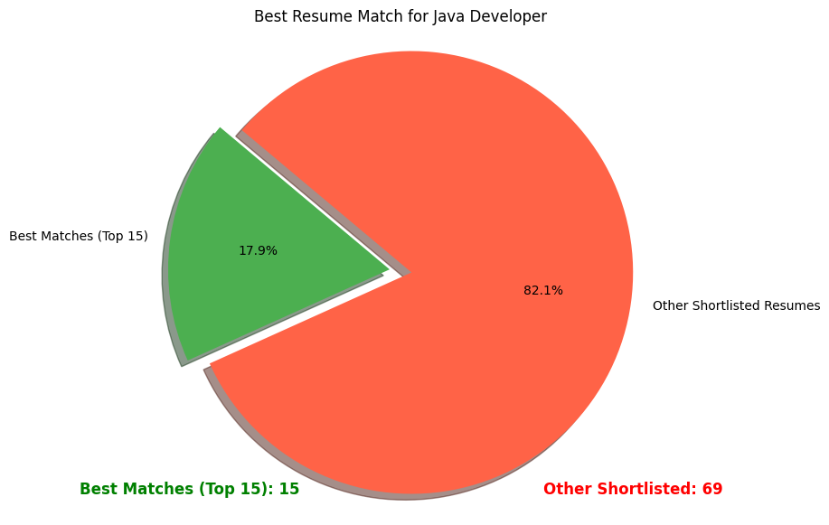
Result Analysis
Figure 5: Resume status for particular job role(Data Science)
Figure 6: Best Resume matches for the role selected
DEPARTMENT OF CSDS, PESITM

Slide 16
Conclusion
Successfully automated resume classification and shortlisting. Reduced HR workload and improved screening accuracy.CSV export and graphical outputs add practical usability.
DEPARTMENT OF CSDS, PESITM

Slide 17
References
Heakl et al. (2024). ResumeAtlas: Revisiting Resume Classification.
https://arxiv.org/abs/2406.181252.
2. Paranthaman et al. (2024). Resume Screening Automation.
https://healthinformaticsjournal.com/index.php/IJMI/article/view/10933.
3. Anonymous. (2020). Resume Recommendation System.
https://www.sciencedirect.com/science/article/pii/S187705092030750X
Gan et al. (2024). LLM Agents in Recruitment. https://arxiv.org/abs/2401.08315
5. Bhatia et al. (2019). Resume Parsing using BERT https://arxiv.org/abs/1910.03089
DEPARTMENT OF CSDS, PESITM

